Slide 1
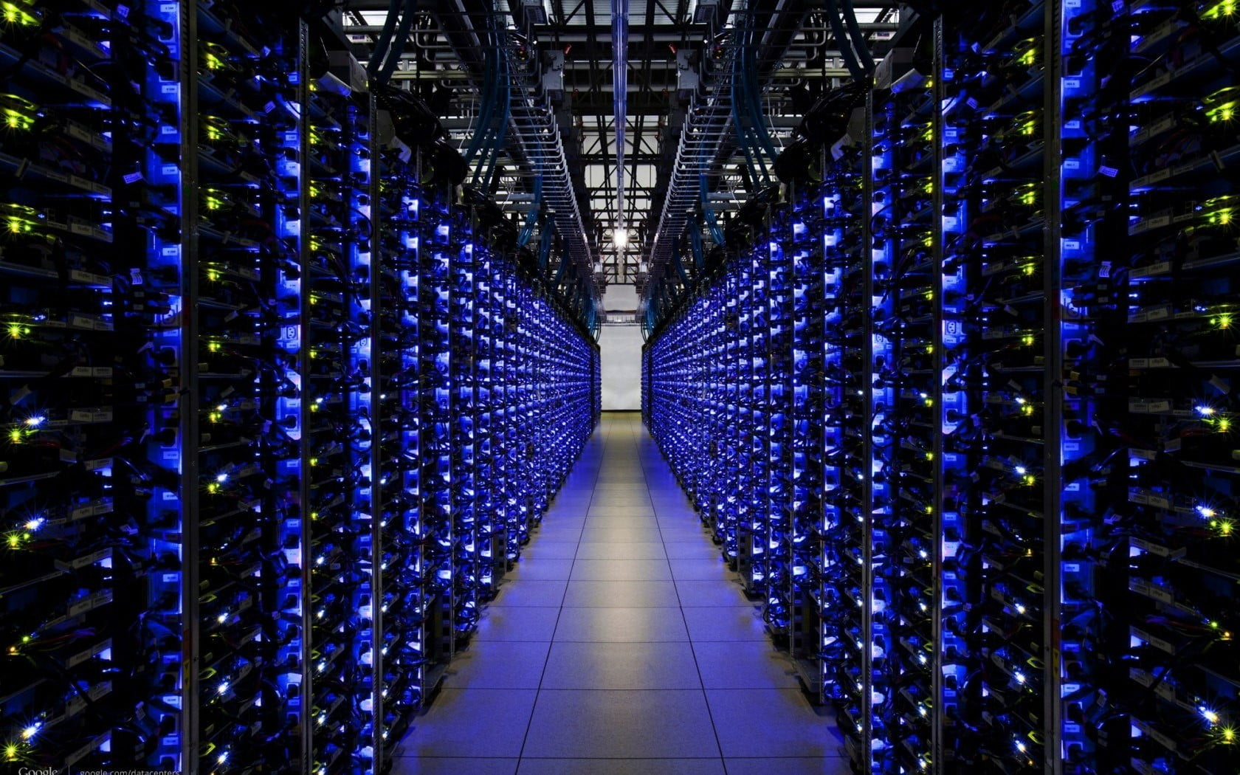
CPU GPU TPU in MLOps
Serdar Biçici
150210331

Slide 2
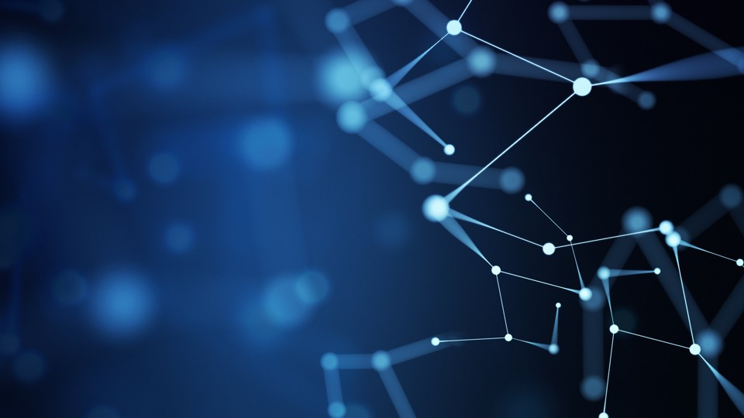
Role of Hardware in MLOps

Slide 3
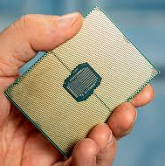
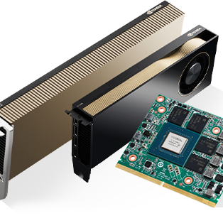
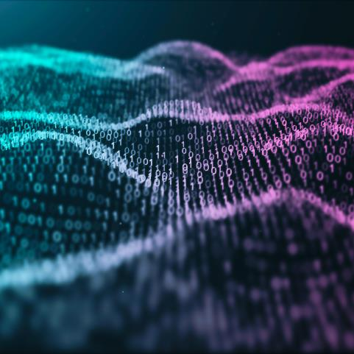
Hardware determines training and inference speed.
Impacts scalability, cost, and deployment efficiency.
Choice depends on model type, data size, and latency needs.
MLOps pipelines use CPUs, GPUs,TPUs, and sometimes NPUs or DPUs.

Slide 4
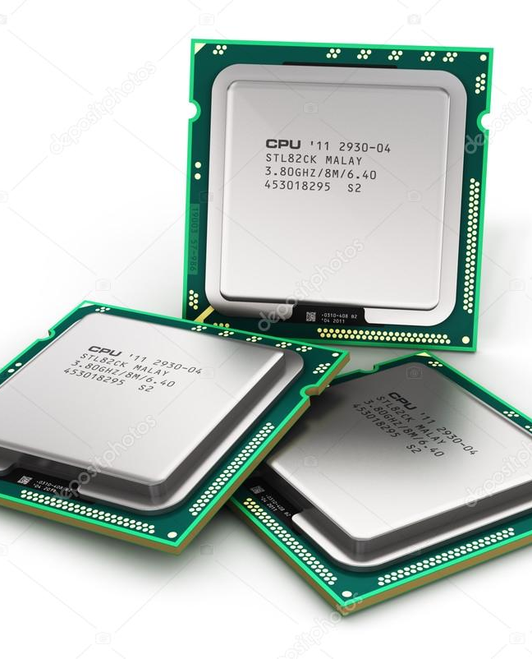
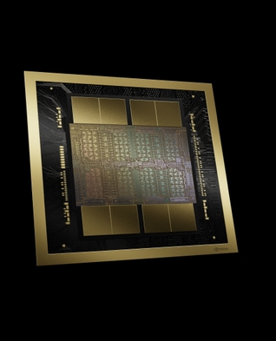
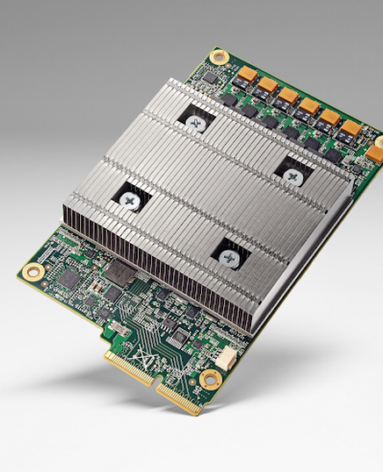
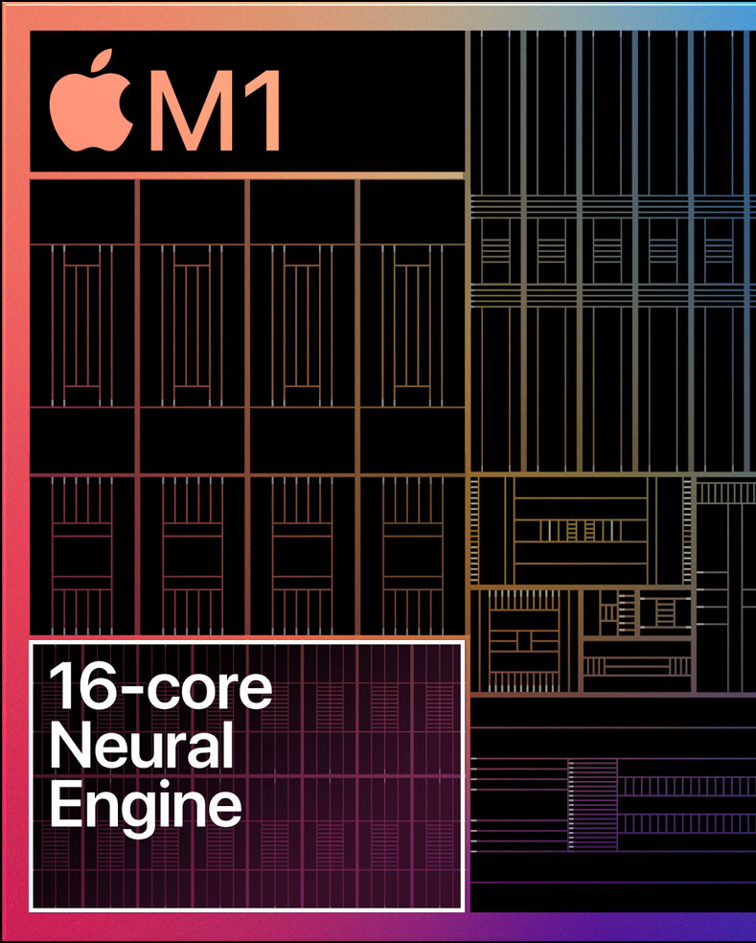
CPU vs GPU vs TPU

Slide 5
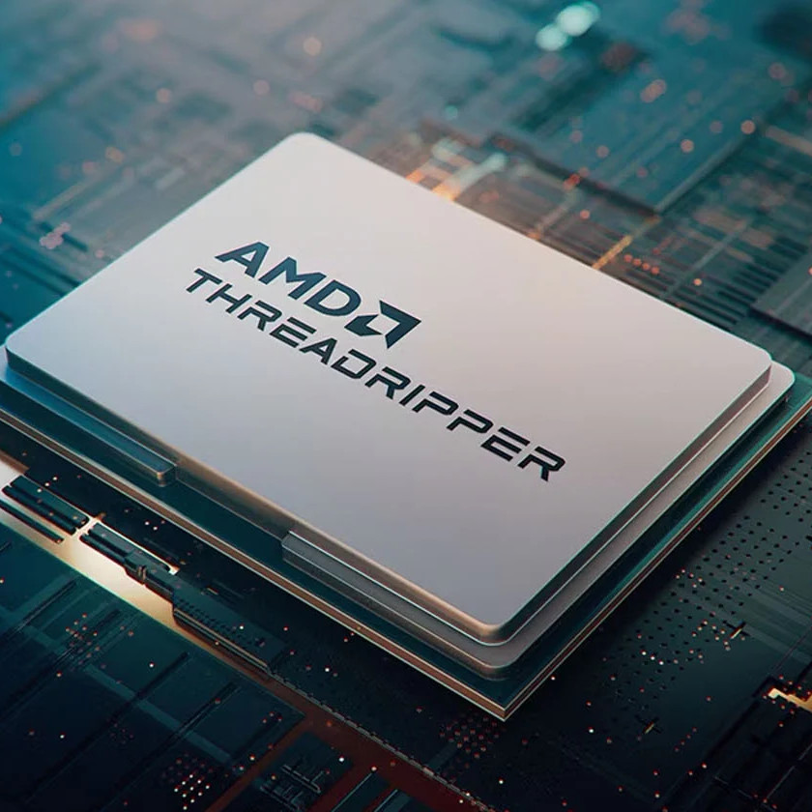
CPU (Central Processing Unit)
General-purpose processor for all computing tasks.
Good for logic, control, and sequential operations.
Limited parallelism (few cores).
Best for data preprocessing, orchestration, light inference.
Found in all servers and edge devices.

Slide 6
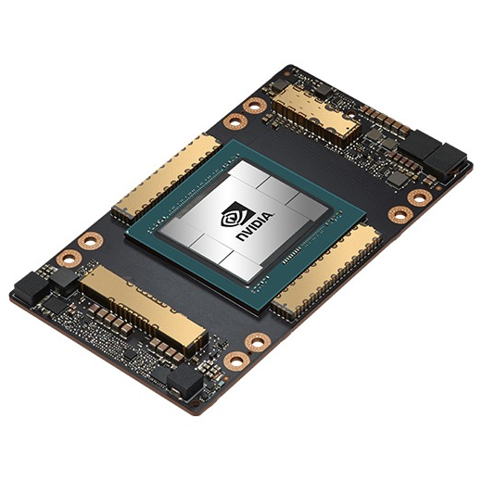
GPU (Graphics Processing Unit)
Designed for massive parallel computation.
Thousands of cores optimized for matrix operations.
Ideal for deep learning training and inference.
High memory bandwidth and compute throughput.
Used widely in AI research and production.

Slide 7
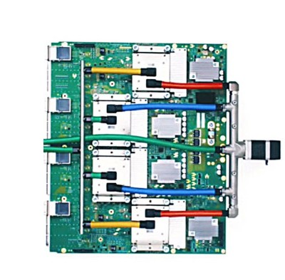
TPU (Tensor Processing Unit)
Custom hardware by Google for neural network workloads.
Optimized for TensorFlow and matrix math.
Extremely fast for deep learning training/inference.
Available only on Google Cloud (TPUs will be sold to other cooperations in 2026)
Less flexible than GPU but more efficient for large models.

Slide 8
Feature | CPU | GPU | TPU
Architecture | Few powerful cores | Thousands of small cores | Custom tensor cores
Parallelism | Low | Very high | Very high (tensor-specific)
Speed (DL tasks) | Slow | Fast | Fastest for TensorFlow
Flexibility | Very high | High | Limited (TF only)

Slide 9
Where to Use What
CPU
GPU
TPU
Small models
Preprocessing
Orchestration
Edge inference
Deep learning workloads
PyTorch/TensorFlow training
Graphical inference
TensorFlow models
Distributed training on Google Cloud

Slide 10
Hardware Experiments

Slide 11

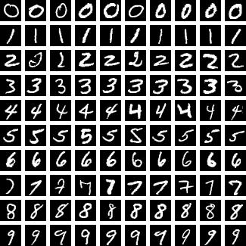
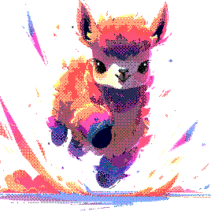
Neural Networks
Gradient Boosting
MINST dataset (60k)
Wine dataset (178)
LLM Inference
TinyLlama-1.1B-Chat-v1.0 model

Slide 12
Training Time (s)

Slide 13
Throughput (samples/s)

Slide 14
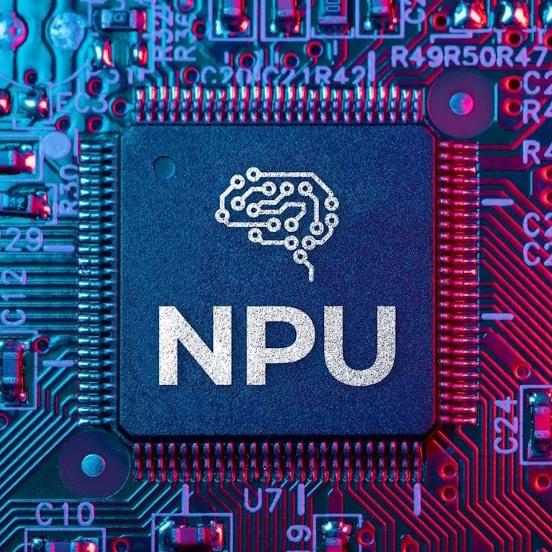
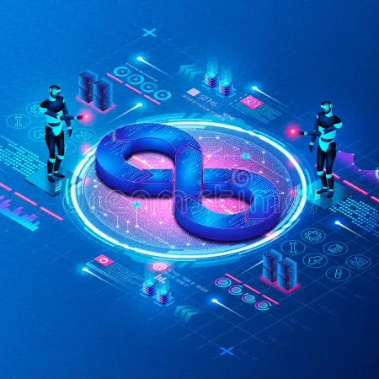
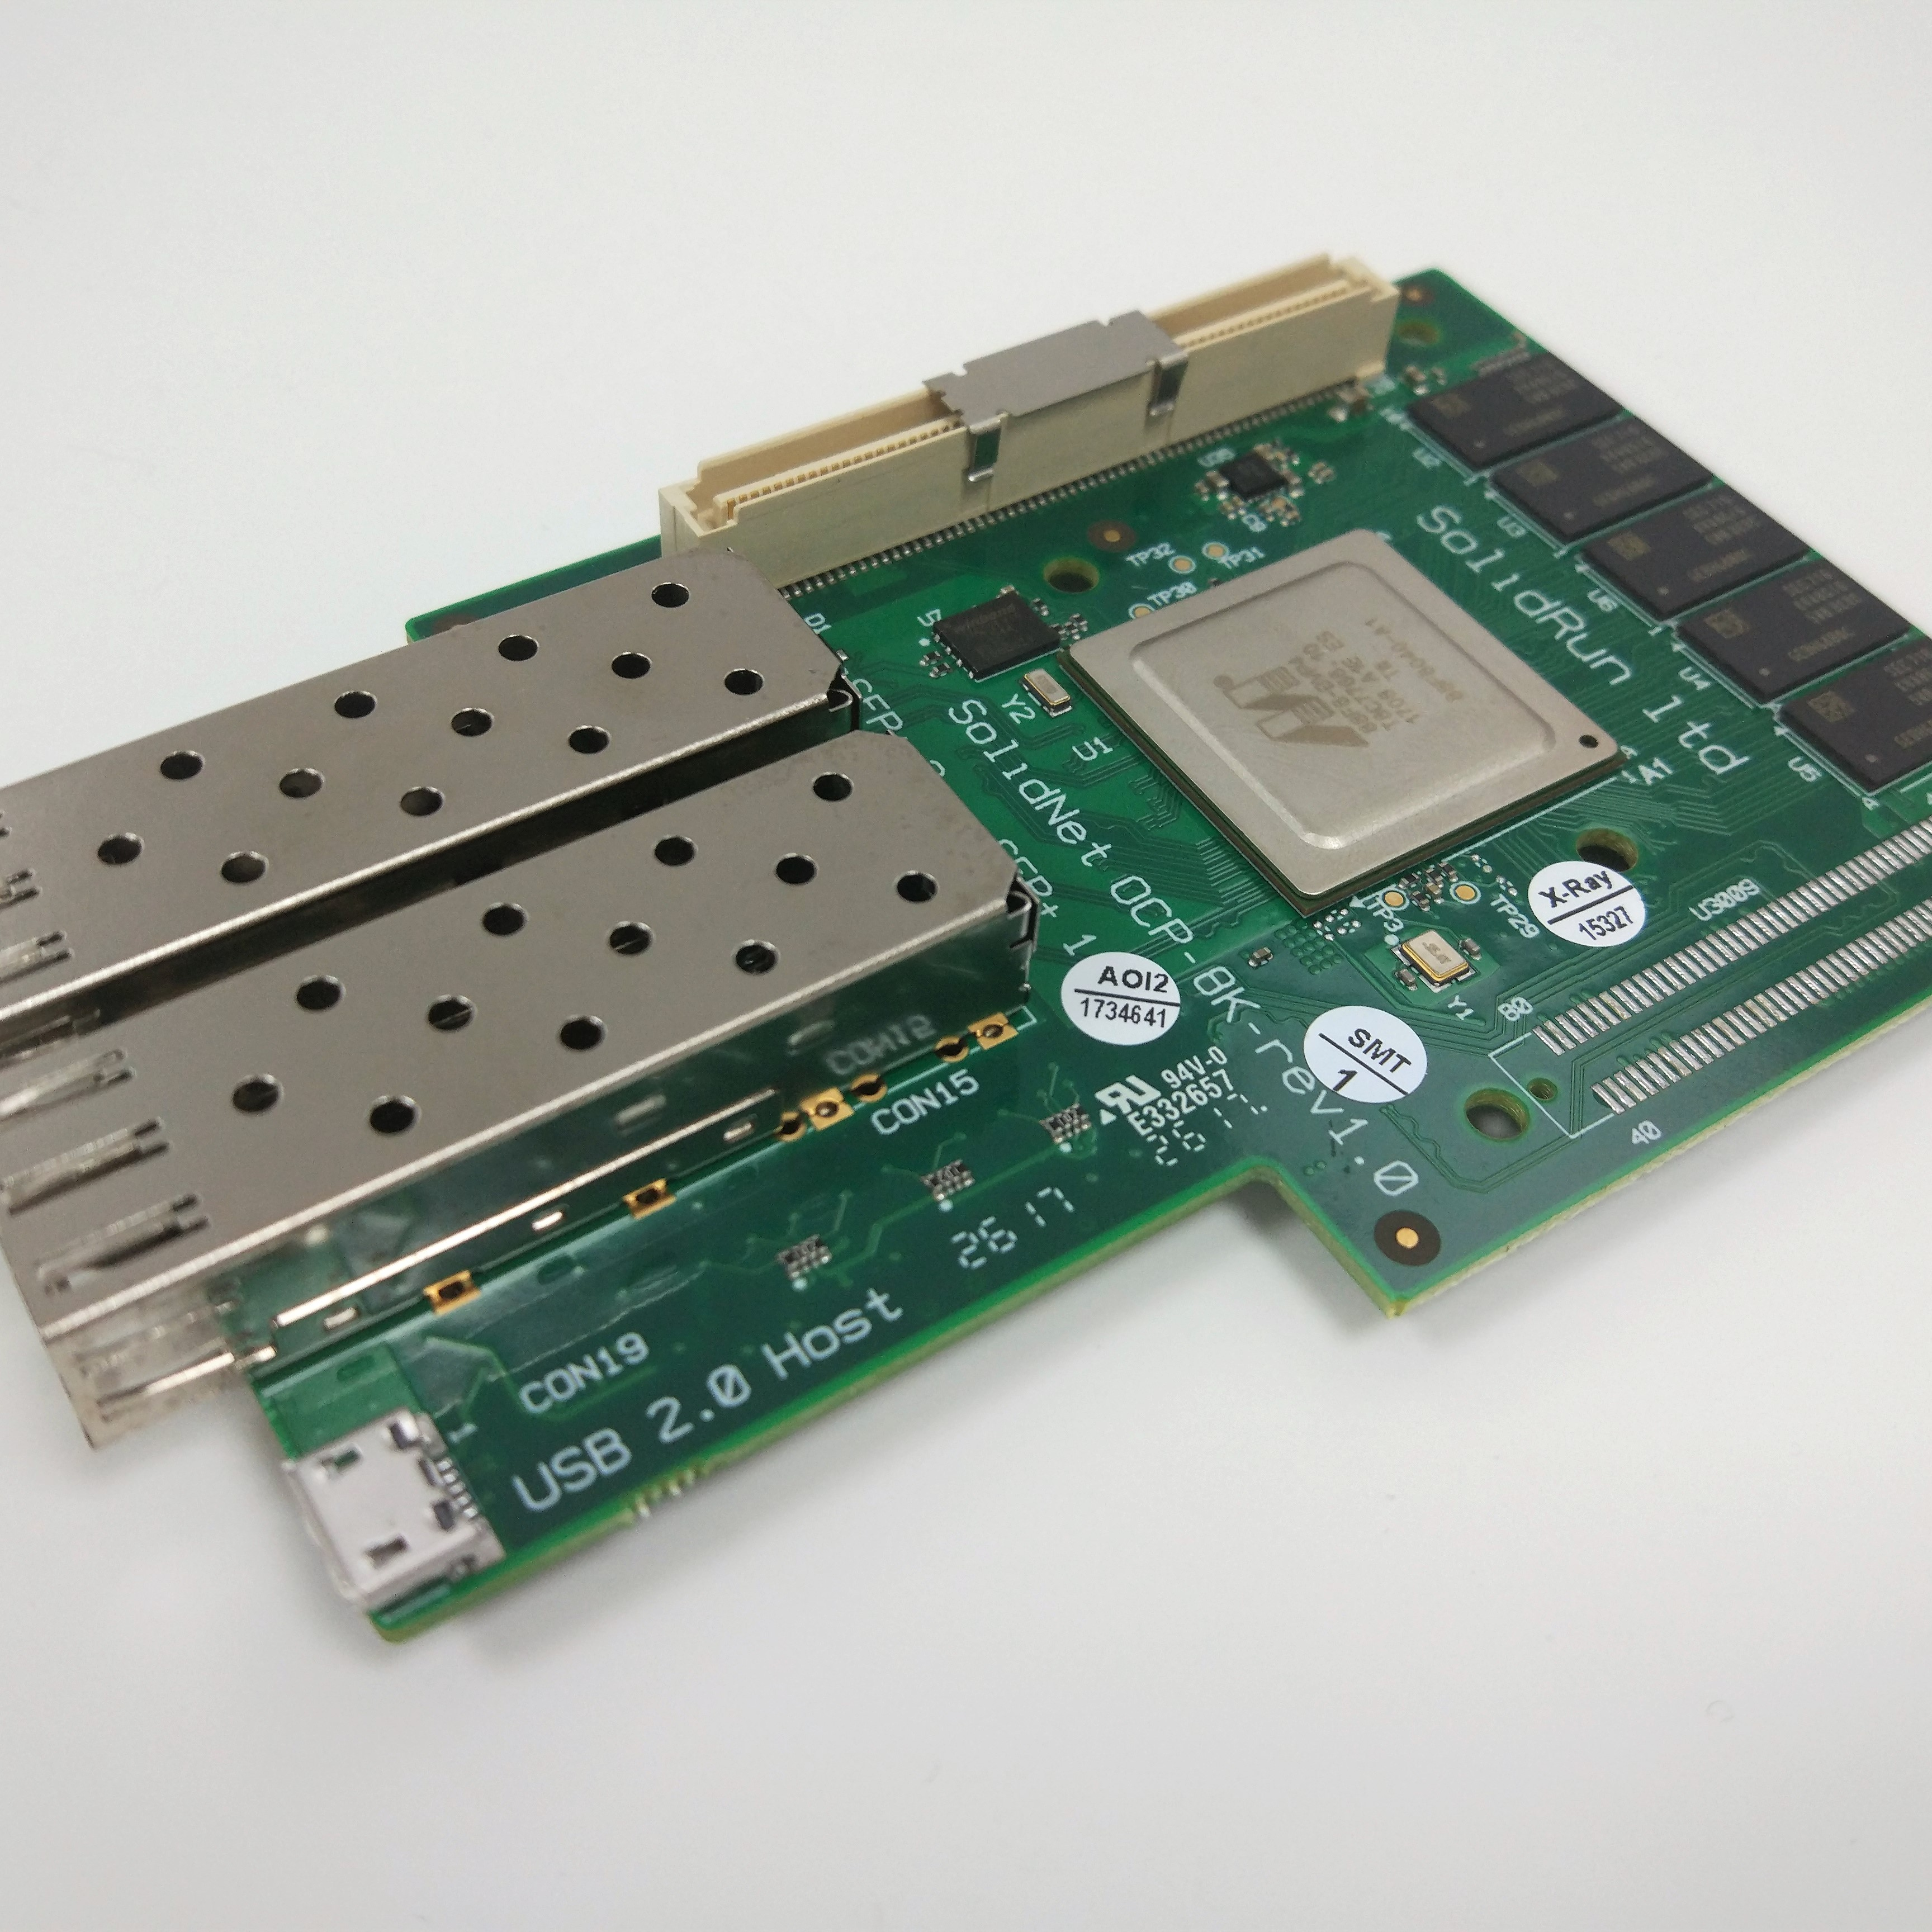
Extra Knowledge
NPU (Neural Processing Unit): on-device AI accelerator
DPU (Data Processing Unit): Offloads networking, encryption, and data tasks from CPU
FPGA (Field Programmable Gate Array): Reconfigurable hardware for custom acceleration

Slide 15


GitHub

